Slide 2
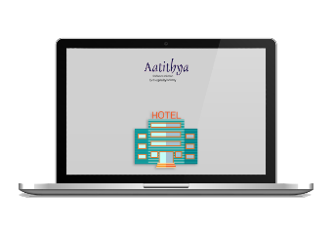
Aatithya - Software Solution for Hospitality Industry
Aatithya, a highly flexible hotel management software that can help hotels from mid-sized to large size properties to automate the entire gamut of operations with maximum ease.
A comprehensive solution in Property Management Systems (PMS) for hotels, hotel chains, resorts, motels, Restaurants, cafés, inns, etc.

Slide 3
Modules
Reservations
Financial Accounts
Front Office
M . I . S
Point Of Sales
Sweet Shops & Bakery
Material Management
Club Management
Banquet Management
Aatithya
Interfaces
House Keeping

Slide 4
Add on Modules
01
SMS Integration
Integration with ARS, Door Lock, Bar Code, EPabx, Channel Manager
02
03
MIS on Mobile
Integration with Weighing Scale, Programmable Key Board
04
05
Loyalty Management
Integration with Tally Accounting Software
06
07
Mobile Apps

Slide 5
Front Office Management
Comprehensive Front Office Dashboard
Display Room Rack
Guest Walk in/Check In
Capture Guest Photo / ID Details
Group Check In / Check out
Expected Arrivals / Departures
Display Room Rack with Guest Details
Room Change / Room Merge
Paid Out Entry
Check in / Check Out Registers
Provisional / Final Checkout Bills
Cashier Settlement Reports
Integration with Online Reservation
Room Availability Chart
Reservation Dashboard
Guest History Tracking
Tentative / Confirm/ Waiting Reservations
Payment Receipts
Mail Confirmation / Cancellation Letter
Plan / Package Bookings
Group Reservations
Travel Agent Bookings
7-730 days Forecast
Guest Pickup details

Slide 6
Point Of Sale
Outlet /Table / Steward / Session Wise Sales
Item wise sales, Cover Analysis
Void Bills Report
Cashier wise Collection & Settlement.
Consumption Variance Analysis
GST Accounting
CRM –Customer Feedback Tracking
Food & Beverage Costing
Integrated with Touch Screen, TAB for Order Booking and Billing
Smart Card Interface
Loyalty Accounting
Outlet define (Room Service/ Restaurant/ Bar/…)
Menu Item & Consumption Tracking
User Defined Table Structure Layout
K.O.T. / Sale Bill Generation
Dine in /Take away / Home Delivery Orders
Centralized KOT option
Delivery Tracking Dashboard
Happy Hours / Schemes & Combos
Multiple Mode Payment Settlement (Cash/Credit/Card/Bill to Company/….)

Slide 7
Material Management
Stock Valuation on Standard Methods
Kitchen Closing Stock
Daily Stock Variance
Kitchen Stock Report Issue/Receipt Basis
Excess Consumption Report
ABC Analysis Report
Non Moving Items
FB Cost Statement
Stock Ledger
Supplier Outstanding
Stock Report (Raw/Semi Finished/ Finished Items)
Indent Generation & Approval
Quotation Tracking
Purchase Order by Purchase Department
Material Receipts
Purchase / Purchase Returns
Material Issue to Sub Stores/Kitchen
Stock Transfer
Item Group wise/ Item Wise Stock
Stock above/below Min/Max/Reorder Levels

Slide 8
Banquet Management
Venue Availability
Multiple Catalogue & Menu Preparation
Booking Enquiry & Follow-ups
Indoor / Outdoor Catering Bookings
Function Prospectus
Chef Pre-Costing
Indent to Stores Department
Banquet Billing
A-la-Carte Sales
Party wise Outstanding
Item Wise Sales
Date wise Booking Chart
Tax Reports
Guest Feedback & Observation Report

Slide 9
House Keeping
Housekeeping Room Display Screen
(Clean/Dirty/Out of Order/Checkout Clearance)
Item Issue /Receipt from Room
Lost & Found and Claim Management.
Room Block
Complaint & Clearance Management
Item Issue / Receipt from Supplier
Supplier wise Stock Report
Item Wise Stock Report
Guest Laundry Billing
Service Bill Entry
Room Status Report

Slide 10
Financial Accounting
Integration with Other Modules
Voucher Generation (Cash/Bank/Journal)
Cash / Bank Books
Ledgers
Bank Reconciliation
Credit Note/ Debit Notes
Trial / Sub Trial Balance
Profit & Loss Statement
Balance Sheet
Ageing Analysis of Debtors/Creditors
Cash Flow / Fund Flow
Bill wise Outstanding Reports
Night Audit Reports

Slide 11
Sweet Shop/ Bakery Management
Indent to Production Unit
Raw Material Requirement & Procurement
Production Process
Festive Order Booking
Party wise Item Wise Rates
Sale Order, Dispatch & Returns
Challan & Tax Invoice Generation
Stock Transfer Between Stores & Outlets
Bar Code Billing Provision
User Defined Combo & Schemes
Define Mix Items Packing on Spot Billing
Bardana Stock Tracking
Sales Forecasting & Analysis
GST Accounting

Slide 12
Club Management
Member Admission
Member Detail (Personal & Family Details)
Monthly Subscription & Billing
Member Smart Card Interface at POS
Member Outstanding
Facilities Availed by a Member
Swimming Pool/ Cards/ Pool/ Other Sports
Track Member Coming from Reciprocal Clubs
Birthday and Marriage Reminders
Member Portal Integration
Member Mobile App Integration

Slide 13
Interfaces
Aatithya Provides seamless Integration with
Automatic Door Locks
Web Cam
Biometric Devices
Touch Screen Monitors
Tab / PDA / Touch Enabled POS
Epabx
Weighing Scales
Bar Code Readers
Programmable Key Boards
Bluetooth Printers
Smart Card Reader/Writer
Credit Card Readers
Tally Accounts

Slide 14
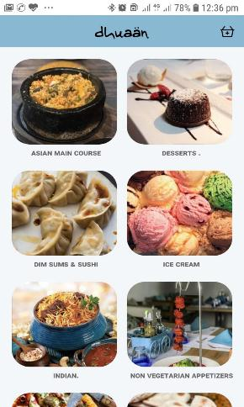
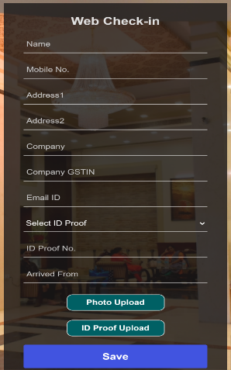
Mobile Apps
QR based Pos Food Ordering
Online Food Ordering
Contactless Web Check-in

Slide 15
Aatithya Advantage
30+ Years Experience in Software Domain
Successfully executed at more than 1500 Hospitality Clients
Supported by Strong Team of 250 Professionals
Configurable Multi Level Security
User Friendly Interface to increase Staff Efficiency
Real-time Business Monitoring
Better Quality of Care, Service to Patients
Reduce Operating Costs
Control Pilferages & Leakages
Comprehensive reporting and analytics System

Slide 16
01
02
03
Focus on organic growth
Clientele in
15 countries and 22 states of India
Over 15% Growth in 2018-19
Founded in 1990 in India
Specializes in providing flexible business-oriented solutions.
Significant cash reserves & zero debt
The Company
Over 5000 Clients
04
Spread in 140 Cities
05
06
Functional expertise in Healthcare, Hospitality, Education, Construction
Expertise on
.NET, Open source, Mobile, Desktop & Web Application.
Customer centric onsite offshore model with focus on quality & Security Process

Slide 17
Certifications & Empanelment
Certifications
Empanelment's
Technical Trading Empanelment
CMMi Level 5
NSIC Empaneled Company
STPI (Software Technology Parks of India)
NSE (National Stock Exchange) Empaneled Vendor For Share Trading/Finance Related Software Provider
ISO 9001 for Quality Assurance
Department of Telecommunication
ISO 27001 for Security Assurance
Ministry of Social Justice & Empowerment
NCDEX

Slide 18
www.dataman.in
Office : Kanpur | Delhi | Mumbai | Chandigarh
Thank You

