Slide 2
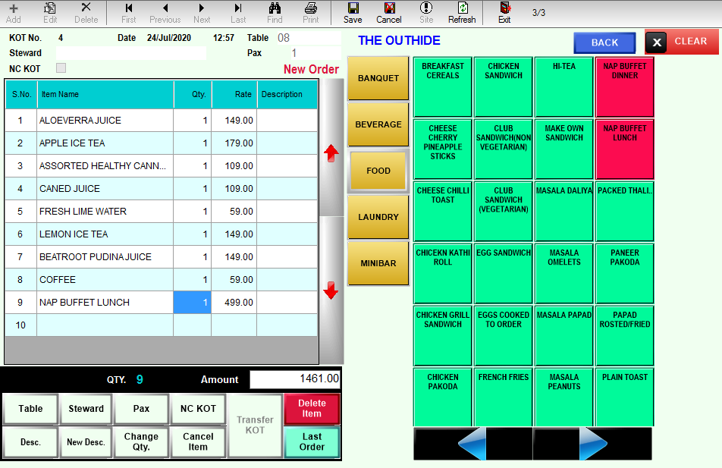
Aatithya Pos
Aatithya Pos is a state of art Point of Sale software for Fine Dine, Take away, Home Delivery Restaurants, Bars, Lounges, Sweet Shops and Bakery outlet chains, Cafes, Ice cream Parlors and Food Courts.

Slide 3
Modules
05
CRM & Loyalty
Pos Billing Module
01
06
Banquet Module
Material Management
02
07
Financial Accounts
Sweet Shop & Bakery
03
08
Interfaces
Production Module
04
09
Mobile Apps

Slide 4
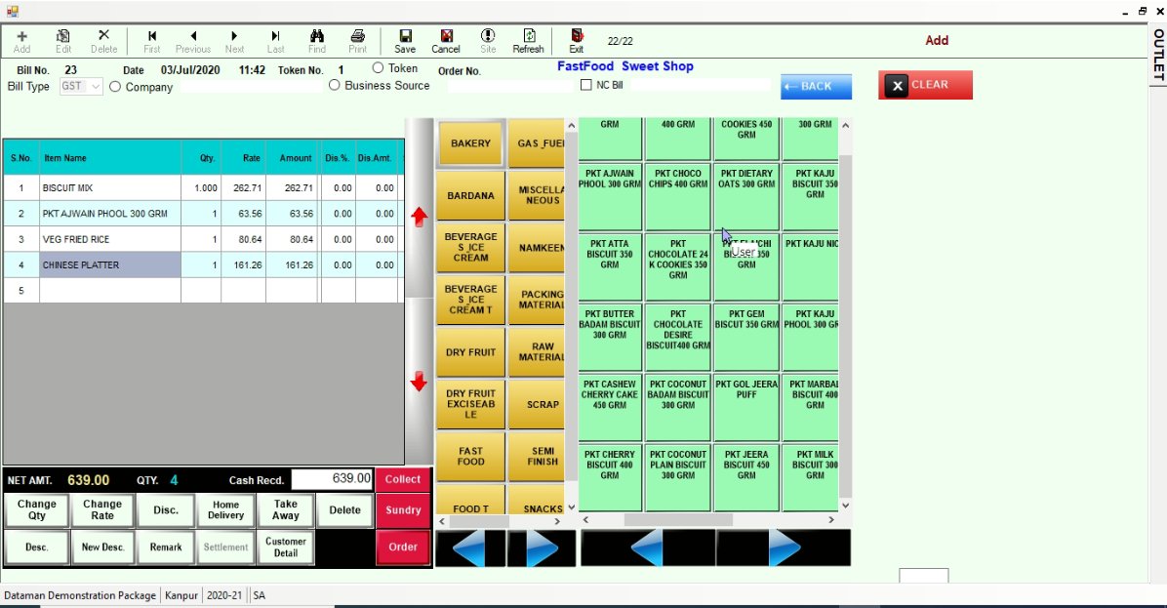
Point Of Sale
Dine in /Take away / Home Delivery Orders
Dynamic Menu Creation
User Defined Table Structure Layout
K.O.T. / Token / Sale Bill Generation
Centralized KOT option
Delivery Tracking Dashboard
Happy Hours / Schemes & Combos
Multiple Mode Payment Settlement (Cash/Credit/Card/Bill to Company/Wallet/….)
Outlet /Table / Steward / Session Wise Sales
Item wise sales, Cover Analysis
Void Bills Report
Cashier wise Collection & Settlement.
Food & Beverage Costing
Recipe Planning & Consumption analysis

Slide 5
Material Management
Indent from Kitchen & Sub stores
Vendor Quotations & Analysis
Purchase Order generation
Material Receipts
Purchase / Purchase Returns
Material Issue to Sub Stores/Kitchen
Stock Transfer
Item Group wise/ Item Wise Stock
Stock above/below Min/Max/Reorder Levels
Stock Valuation on Standard Methods
Kitchen Closing Stock
Excess Consumption Report
Daily Stock Variance
ABC Analysis / Non moving Items
F & B Costing

Slide 6
Sweet Shop/ Bakery Management
Indent for finished item to Production Unit
User Defined Combo & Schemes
Define Mix Items Packing on Spot Billing
Token Generation / Billing
Bar Code Billing
Festive Order Booking
Party wise Item Wise Rates
Challan & Tax Invoice Generation
Stock Transfer Between Factory & Outlets
Sales Forecasting & Analysis
GST Accounting
Data Synchronization between H.O. & Outlets
Suitable for Single outlet or chain of outlets

Slide 7
Production Module
Receive indents from Sale Outlets
Track Bill on Material based on Orders recd.
Raw Material procurement
Issue Raw Materials for Production
Receipt finished items from Production
Maintain Bardana Stock
Stock Transfer from Factory to Outlets
Define Company wise Item wise rates
Receive Sales order from Parties
Challan & Tax Invoice generation
Data Sync between Factory and H.O.
Track Wastage & Damaged Stock
Expiry Tracking

Slide 8
CRM / Loyalty Module
Maintain Customer Database
Review Customer Order history
Customer Feedback Tracking
Complaints & Response
Birthday/Anniversary Reminders
Customer Outlet visit report
Loyalty Points Management
SMS for offers and Discounts

Slide 9
Banquet Management
Venue Availability
Multiple Catalogue & Menu Preparation
Booking Enquiry & Follow-ups
Indoor / Outdoor Catering Bookings
Function Prospectus
Chef Pre-Costing
Indent to Stores Department
Banquet Billing
A-la-Carte Sales
Party wise Outstanding
Item Wise Sales
Date wise Booking Chart
Tax Reports
Guest Feedback & Observation Report

Slide 10
Financial Accounting
Integration with Other Modules
Voucher Generation (Cash/Bank/Journal)
Cash / Bank Books
Ledgers
Bank Reconciliation
Credit Note/ Debit Notes
Trial / Sub Trial Balance
Profit & Loss Statement
Balance Sheet
Ageing Analysis of Debtors/Creditors
Cash Flow / Fund Flow
Bill wise Outstanding Reports
Night Audit Reports

Slide 11
Interfaces
Aatithya Pos provides seamless Integration with
Touch Screen Terminals
KOT on Tab
MIS on Android / iOS
Weighing Scales
Bar Code Readers
Programmable Key Boards
Bluetooth Printers
Loyalty Management
Smart Card Reader/Writer
Credit Card Readers
Payment Gateway API’s
Tally Accounts

Slide 12
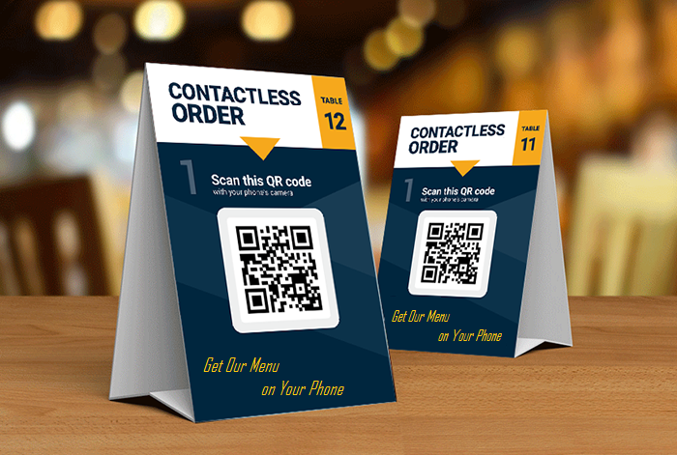
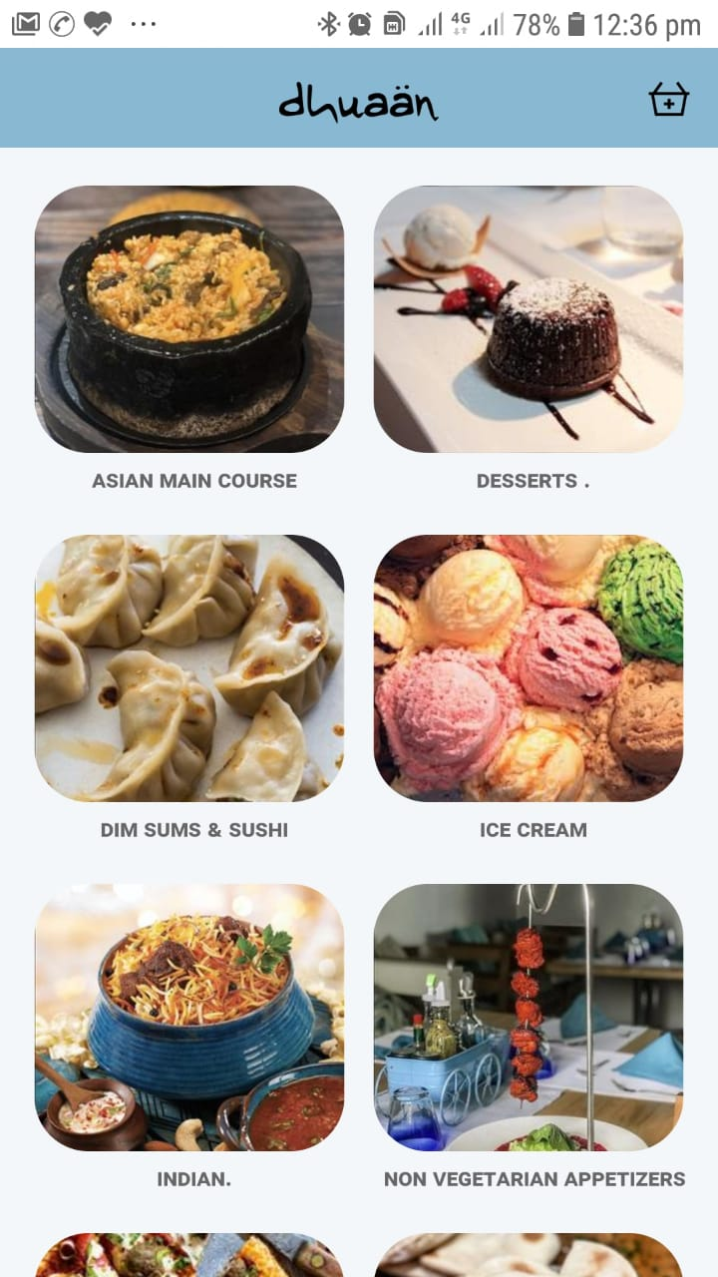
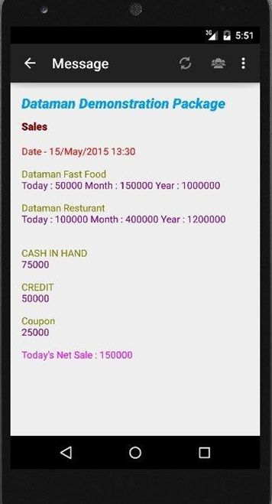
Mobile Apps
QR Menu Ordering App
Mobile food Ordering App
Mobile M.I.S. App

Slide 13
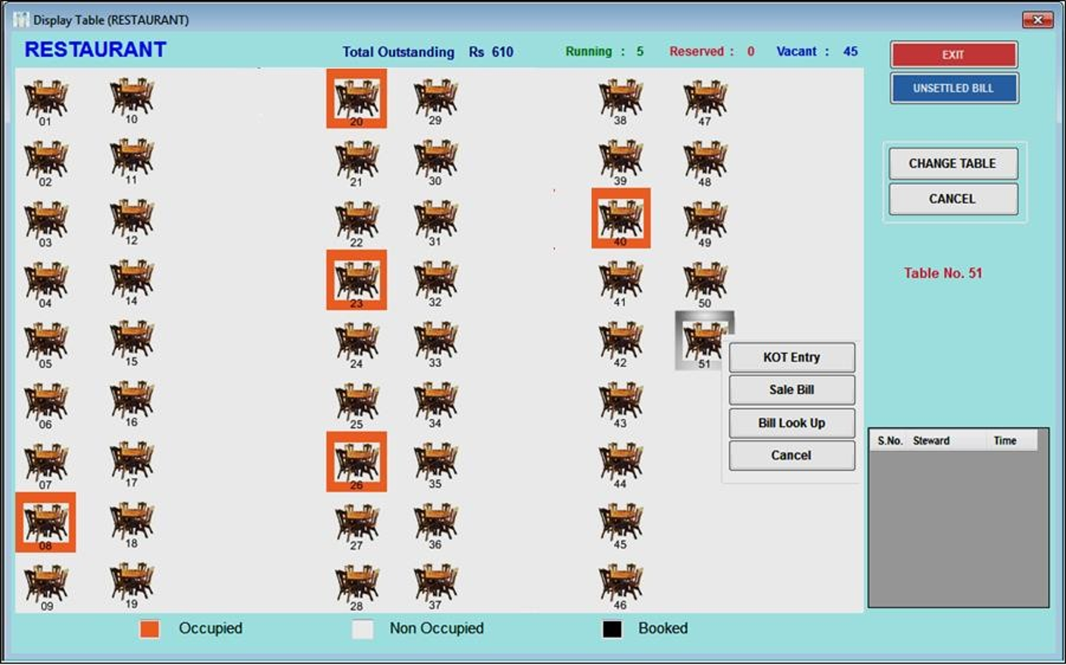
SCREENSHOT
Restaurant Table Display

Slide 14
Aatithya Advantage
30+ Years Experience in Software Domain
Successfully executed at more than 1500 Hospitality Clients
Supported by Strong Team of 250 Professionals
Configurable Multi Level Security
User Friendly Interface to increase Staff Efficiency
Real-time Business Monitoring
Better Quality of Care, Service to Patients
Reduce Operating Costs
Control Pilferages & Leakages
Comprehensive reporting and analytics System

Slide 15
01
02
03
Focus on organic growth
Clientele in 15 countries and 22 states of India
Over 15% Growth in 2018-19
Founded in 1990 in India
Specializes in providing flexible business-oriented solutions
Significant cash reserves & zero debt
Company
Team of More than 250 Resources serving Over 5000 Clients
Spread in 140 Cities
04
05
06
Functional expertise in Healthcare, Hospitality, Education, Construction
Expertise on .NET, Open source, Mobile, Desktop & Web Application.
Customer centric onsite offshore model with focus on quality & Security Process

Slide 16
www.dataman.in
Office : Kanpur | Delhi | Mumbai | Chandigarh
Thank You

